Slide 1
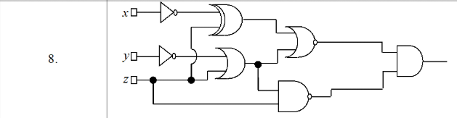
Problem Statement
Exercise 1.8
Write the corresponding Boolean function associated to the following logic circuit, then simplify it and draw a simplified equivalent circuit using only basic gates:

Slide 2
Theoretical results
Binary Boolean algebra provides a concise way to express the operation of a logic circuit formed by a combination of logic gates so that the output can be determined for various combinations of input values.
The basic elements used to build electronic circuits are called basic gates and they implement one of the Boolean operations: ∧, ∨, ̅ .
A gate takes the values from its input wires and combines them with the appropriate Boolean operation to produce the label on its output wire.
A Boolean function models the functionality of a logic circuit
The variables used in the function’s expression are represented by the inputs of the circuit. Each wire in the circuit represents some part of the expression. The final output of the whole circuit represents the function’s expression.

Slide 3
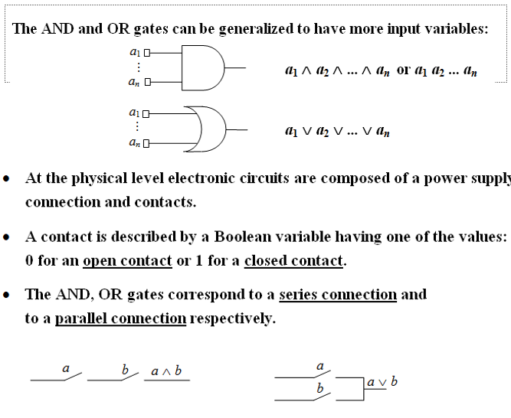
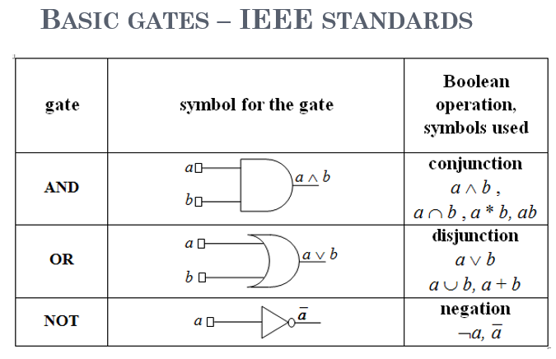
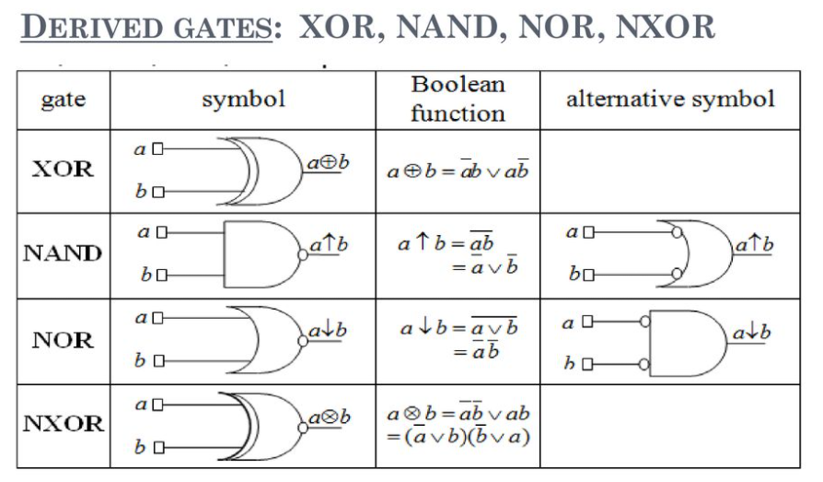
Theoretical results

Slide 4
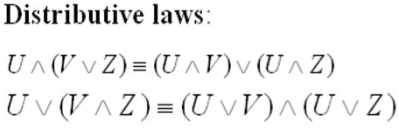
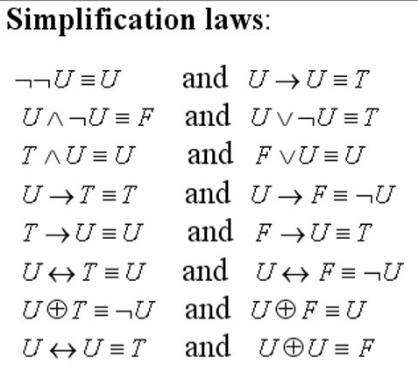
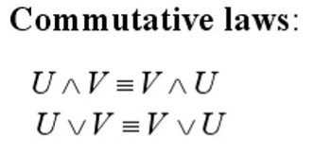
Theoretical results
Simplification laws that can be applied in order to obtain a much simpler version of the function.
Distributive and commutative laws help us to order the variables such that we can see better the simplifcations

Slide 5
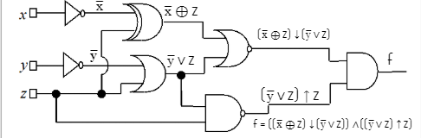
Solving the exercise
We begin the solution by analyzing the logic circuit and write useful outputs of every logic gate.

Slide 6
Solving the exercise
Now, we will complete the following table, and we will obtain that only max = m = xyz̅ is the only maximal monoun, so the most simplified version of f = max = xyz̅
x | y | z | x̅ ⊕ z | y̅ ∨ z | (x̅ ⊕ z) ↓ (y̅ ∨ z) | (y̅ ∨ z) ↑ z | f
0 | 0 | 0 | 1 | 1 | 0 | 1 | 0
0 | 0 | 1 | 0 | 1 | 0 | 0 | 0
0 | 1 | 0 | 1 | 0 | 0 | 1 | 0
0 | 1 | 1 | 1 | 1 | 0 | 0 | 0
1 | 0 | 0 | 0 | 1 | 0 | 1 | 0
1 | 0 | 1 | 1 | 1 | 0 | 0 | 0
1 | 1 | 0 | 0 | 0 | 1 | 1 | 1
1 | 1 | 1 | 1 | 1 | 0 | 0 | 0

Slide 7

Solving the exercise
f(x, y, z) = ((x̅ ⊕ z) ↓ (y̅ ∨ z)) ∧ ((y̅ ∨ z) ↑ z)
We will verify the result from above by transforming derived gates into simple ones.
So, we will have:
x̅ ⊕ z = xz ∨ x̅ z̅
(x̅ ⊕ z ) ↓( y̅ ∨ z) = ((xz ∨ x̅ z̅) ↓ (y̅ ∨ z)) = ((x̅ ∨ z̅) ∧ (x ∨ z)) ∧ y z̅
By applying commutativity, we will have ((x̅ ∨ z̅) ∧ (x ∨ z)) ∧ y z̅ = (x̅ ∨ z̅) ∧ z̅ ∧ (x ∨ z) ∧ y.
By applying absorption law, we will obtain (x̅ ∨ z̅) ∧ z̅ = z̅
Then, (x̅ ⊕ z ) ↓( y̅ ∨ z) = z̅ ∧ (x ∨ z) ∧ y
(y̅ ∨ z) ↑ z = (y ∧ z̅ ) ∨ z̅ and by applying absorption law we have: (y̅ ∨ z) ↑ z = z̅
So, f(x, y, z) = ((x̅ ⊕ z) ↓ (y̅ ∨ z)) ∧ ((y̅ ∨ z) ↑ z) = (z̅ ∧ (x ∨ z) ∧ y) ∧ z̅
By applying distributivity, z̅ ∧ (x ∨ z) = z̅x ∧ z̅z = z̅x
We will obtain f(x, y, z) = ( z̅x ∧ y) ∧ z̅ = xyz̅ ∧ z̅ = xyz̅, so, our calculations were correct!

Slide 8
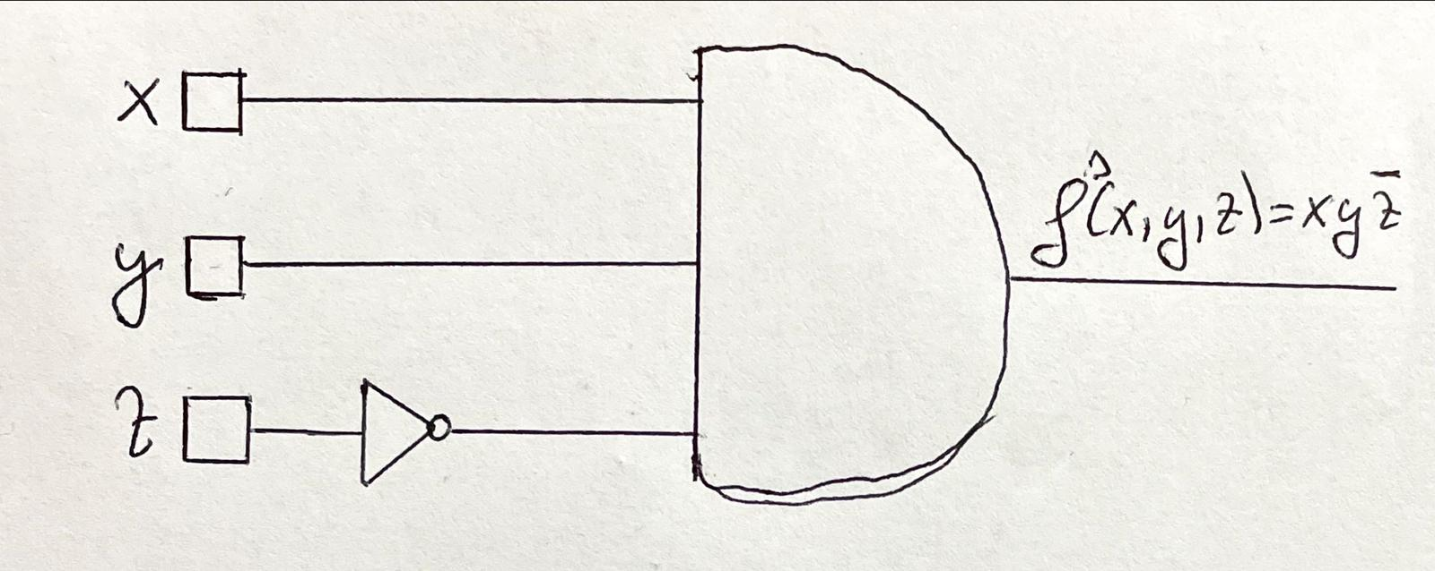
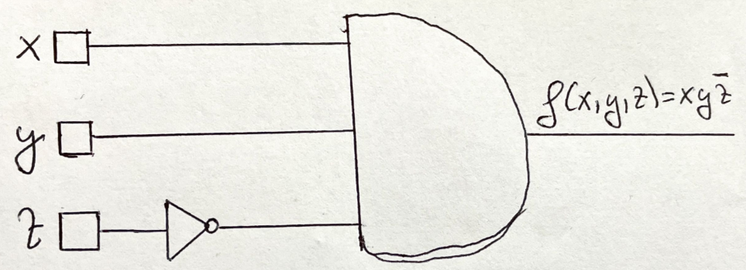
Solving the exercise
Now that we obtained the simplest form as max = m = xyz̅ and C(f) = M(f) = {max} => f^{s} = xyz̅.
The circuit for this function is:

